Slide 1
软件工程大作业展示
2018年12月

Slide 2
Discussion about the combination of the Navigation and Travel Apps
曾乐蔚 516051910054 351035475@qq.com
苗秋实 516051910020 mqs0558@sjtu.edu.cn
陈沛欣 516051910009 381935121@qq.com
张津铭 516021910177 tiaozhanzhe@sjtu.edu.cn
2018年12月7日

Slide 3
目录 Contents
1
Background
2
Idea
3
The collection of the data
4
analysis
5
conclusion

Slide 4
目录 Contents
1
Background
2
Idea
3
The collection of the data
4
analysis
5
conclusion

Slide 5
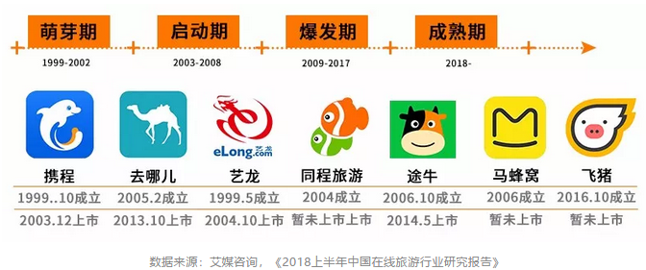
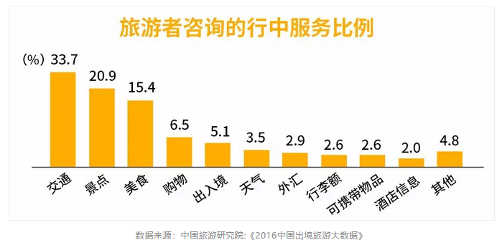
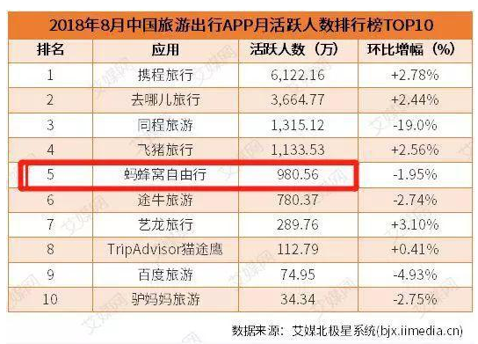
Background
Current status of travel route planning software
People’ attitude towards such apps

Slide 6
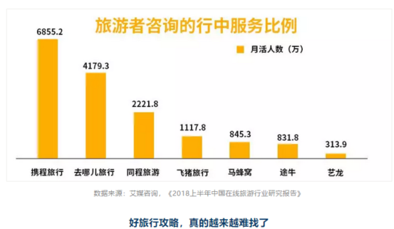




Comparison of the apps
Ctrip
Qunar
LY.com
tuniu.com
Notes:
从这里就可以 解释 后面 选择 携程 和 去哪儿分析 是因为 服务比例高

Slide 7
目录 Contents
1
Background
2
Idea
3
The collection of the data
4
analysis
5
conclusion

Slide 8
Idea
What is the users’ attitude towards such apps?
We want to collect the users’ comments about the apps(navigation&trip)
What does the result tell us?
Do the analysis of the data.
Try to find demand for the app combining navigation and trip plan.
What guidance might be made to these apps?
Give our advice towards such apps.

Slide 9
目录 Contents
1
Background
2
Idea
3
The collection of the data
4
analysis
5
conclusion

Slide 10
The collection of the data
collect the comments about 4 typical apps(高德 百度 携程 去哪儿 )
How to collect the data
1，we choose 3 main app stores to get the comments
ios application store
Huawei application store
Xiaomi application store
Notes:
三个应用2商店的选择没有对比关系。只是三个互相独立的应用商店…对于手机针对使用人群的特异性算是某种程度上的弱化

Slide 11
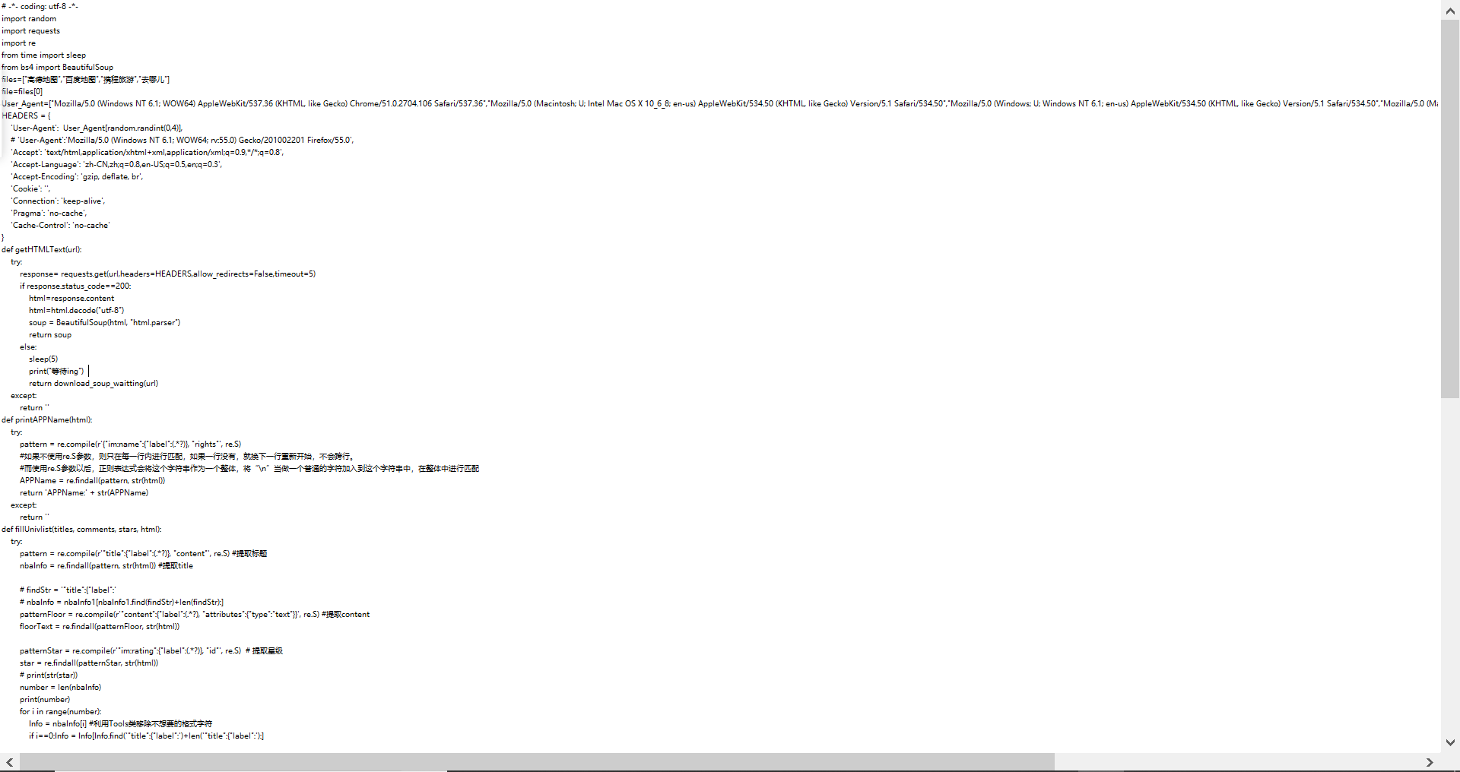
The collection of the data
collect the comments about apps(高德 百度 携程 去哪儿 )
How to collect the data
2，how to collect the comments
for ios, it is easy, using python, we get 500 comments for each app,
excluding the ads.
for android, it is hard, we have to collect the comments by hands
We get the 100 comments for each app, excluding the
ads and other information.
Notes:
先手动分类 然后得到分类标准

Slide 12
The collection of the data
collect the comments about apps(高德 百度 携程 去哪儿 )
How to classify the comments
Nave Bayes classification
Based on bayesian theorem, it is widely used in the classification of
Internet news, spam filtering and other classification tasks.
Notes:
数据都是这样搞出来的

Slide 13
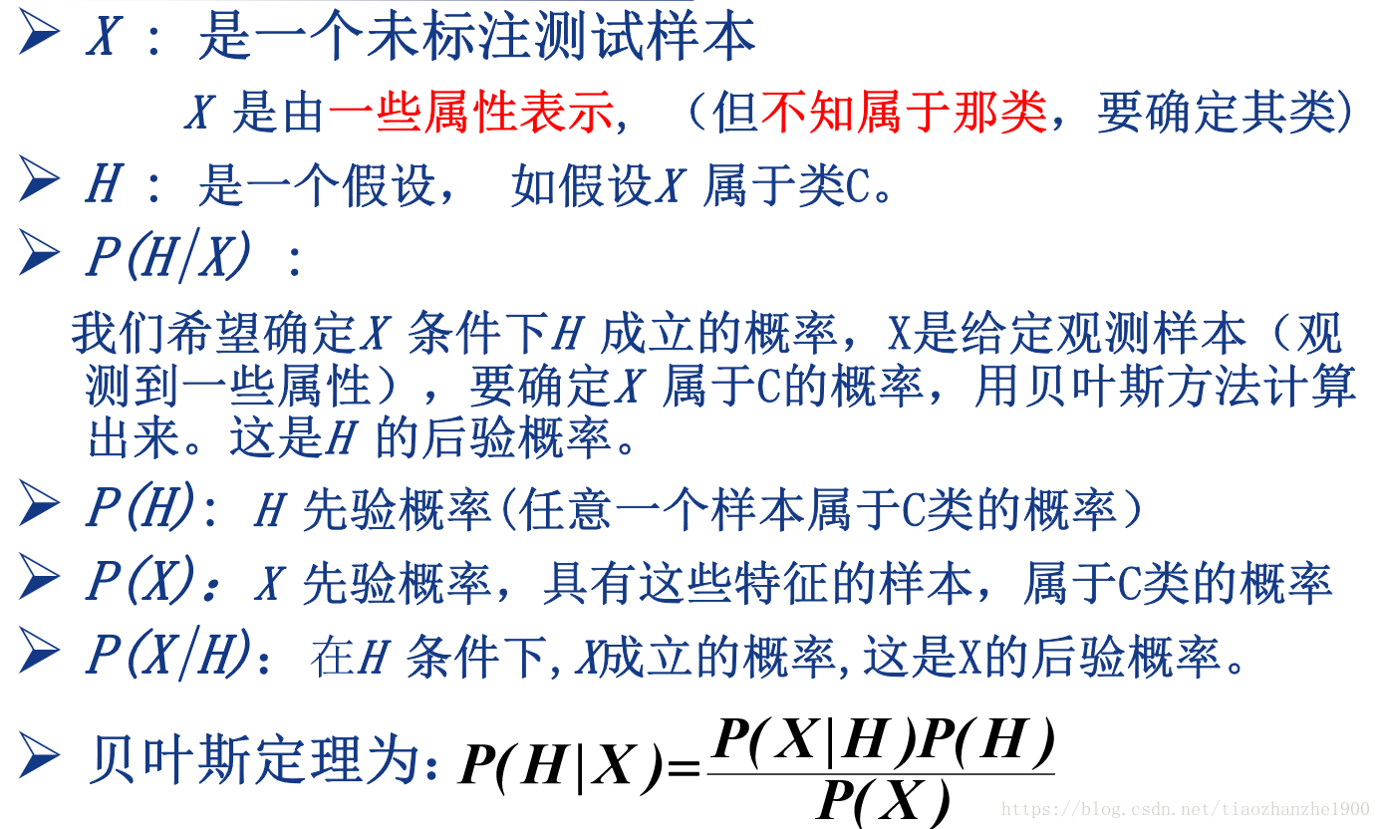
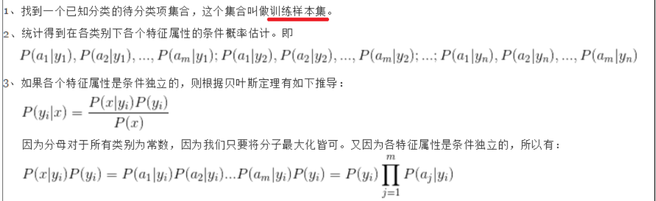
The collection of the data
Nave Bayes classification
Notes:
三

Slide 14
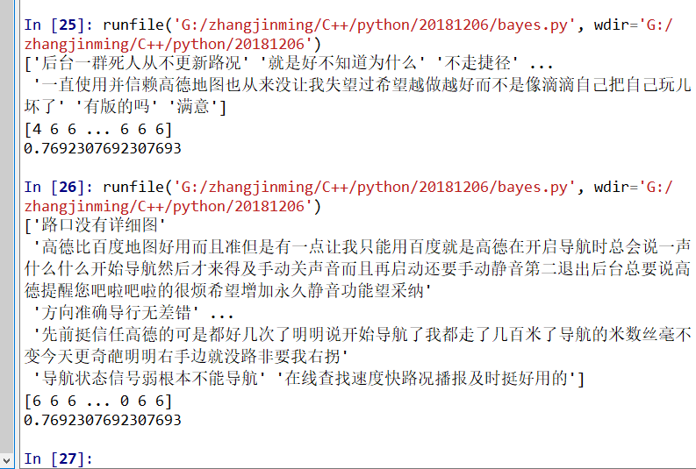
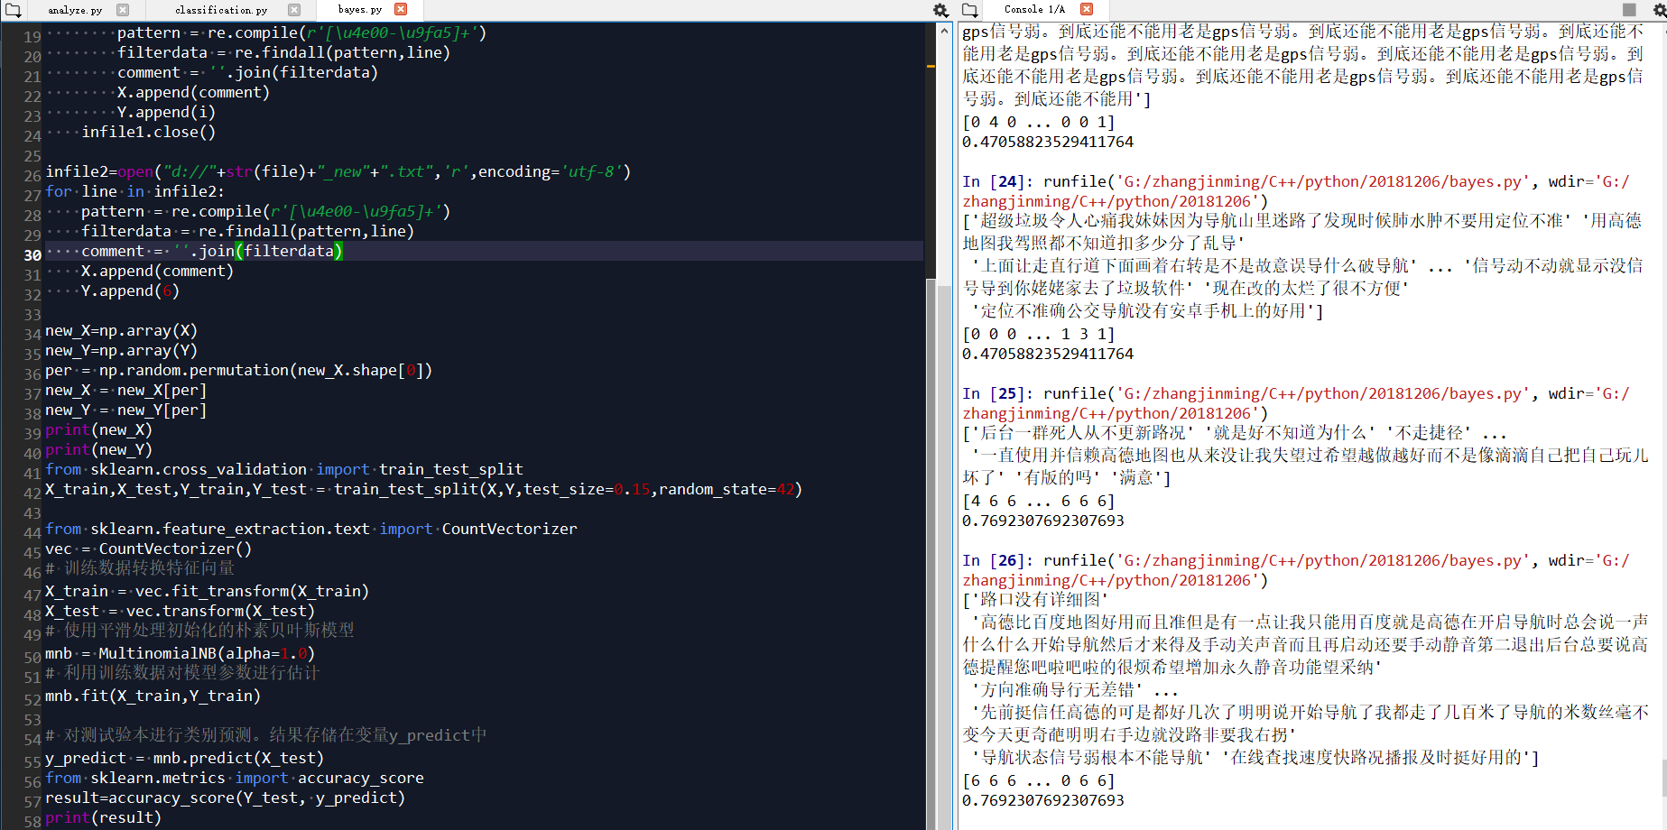
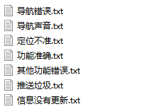
The collection of the data
how to classify the comments
(1) Read the marked data
(2) Remove punctuation marks, count words
(3) Establish Bayes classifier and train with data set
(4) Test set test, and accuracy.（76.9%）
analysis on this classifier
the data are not completely independent
data is not enough
topic is not enough
Notes:
具体内容惨遭 贝叶斯word

Slide 15
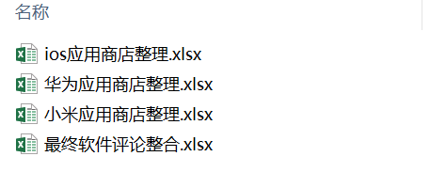
The collection of the data
How to collect the data
3，how to classify the comments
After Nave Bayes classification. we get the result.
Notes:
三个应用2商店的选择没有对比关系。只是三个互相独立的应用商店…对于手机针对使用人群的特异性算是某种程度上的弱化

Slide 16
目录 Contents
1
Background
2
Idea
3
The collection of the data
4
analysis
5
conclusion

Slide 17
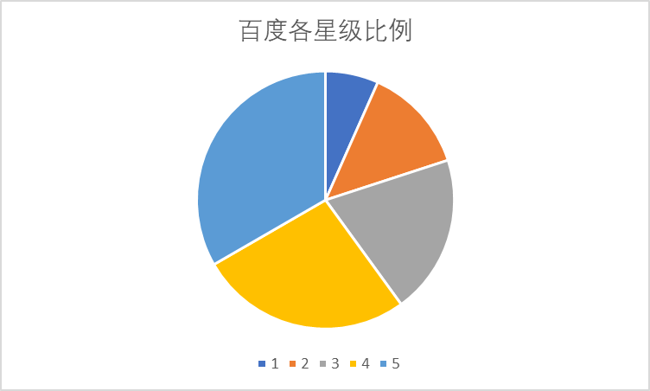
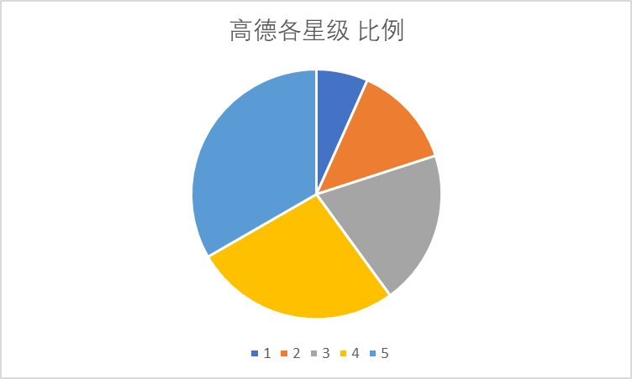
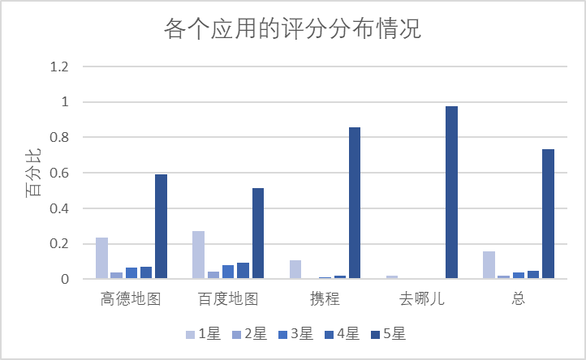

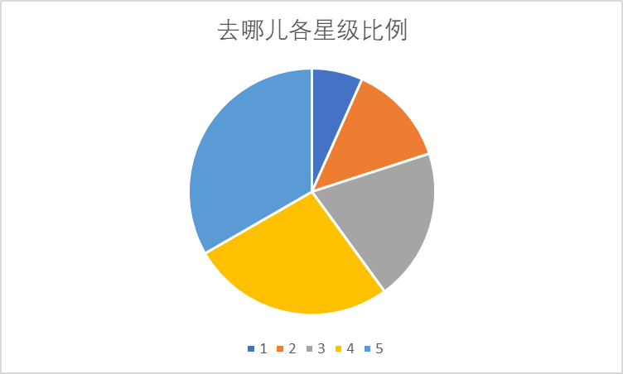
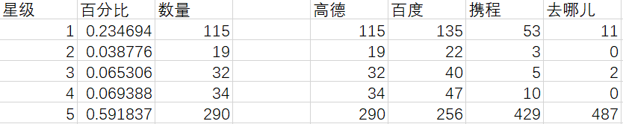
Anaylysis
The relation of the apps and the rank
Notes:
具体内容….简单说一说

Slide 18
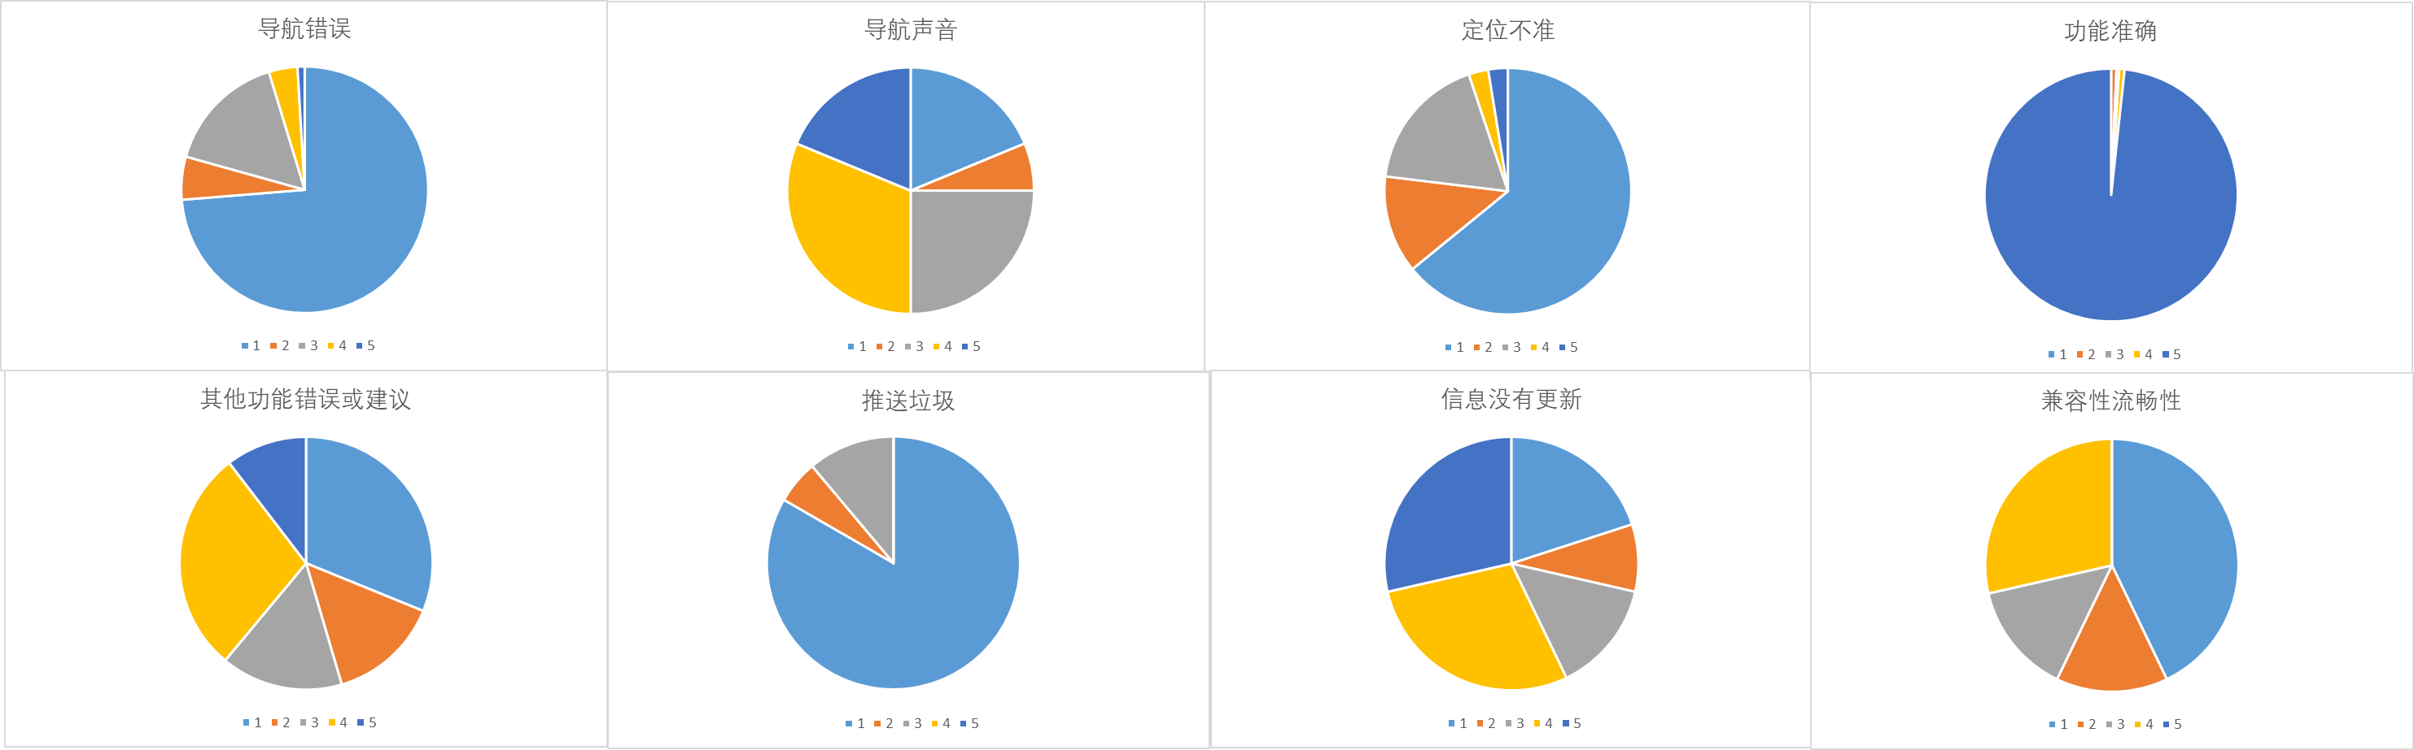
Anaylysis
The distribution of the comment topic
Notes:
具体内容参造评论内容分析word

Slide 19
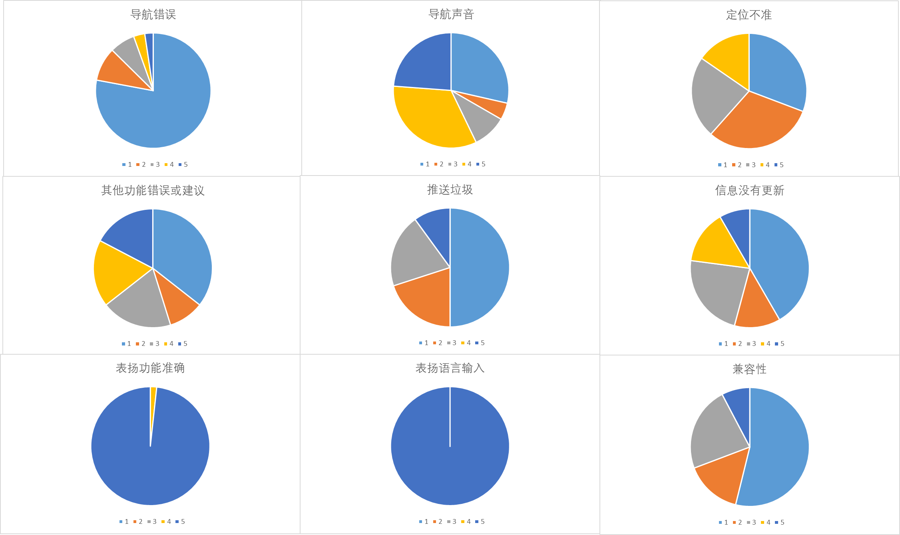
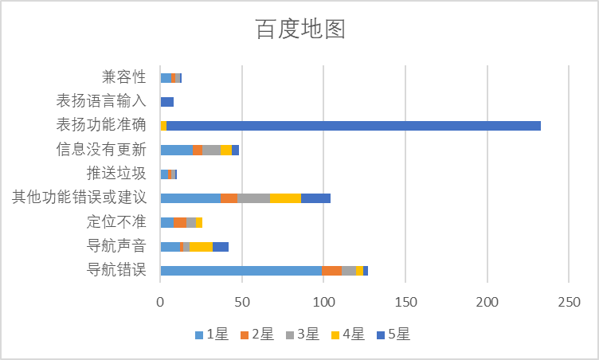
Anaylysis
The distribution of the comment topic
Notes:
具体内容参造评论内容分析word

Slide 20
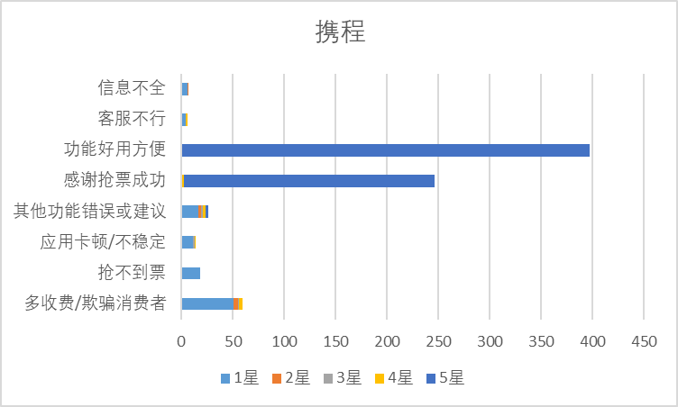
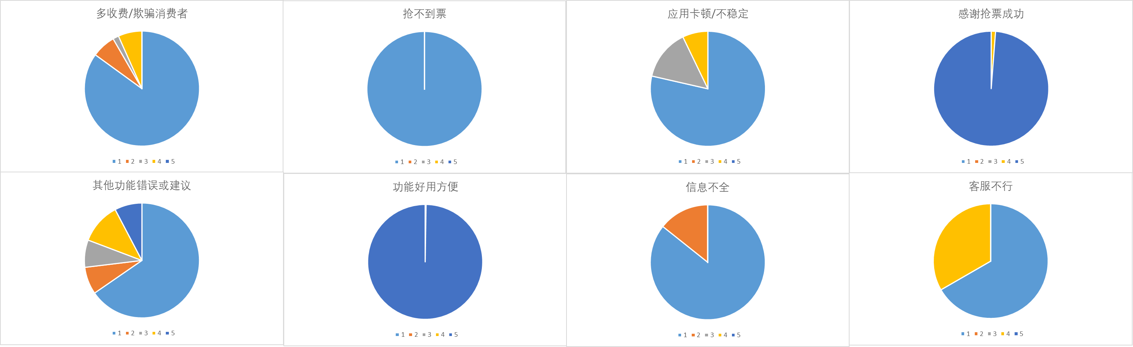
Anaylysis
The distribution of the comment topic
Notes:
具体内容参造评论内容分析word

Slide 21
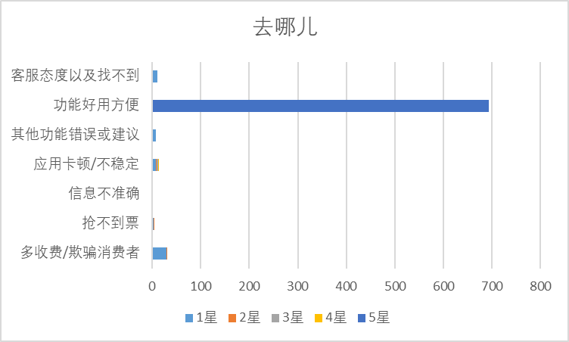
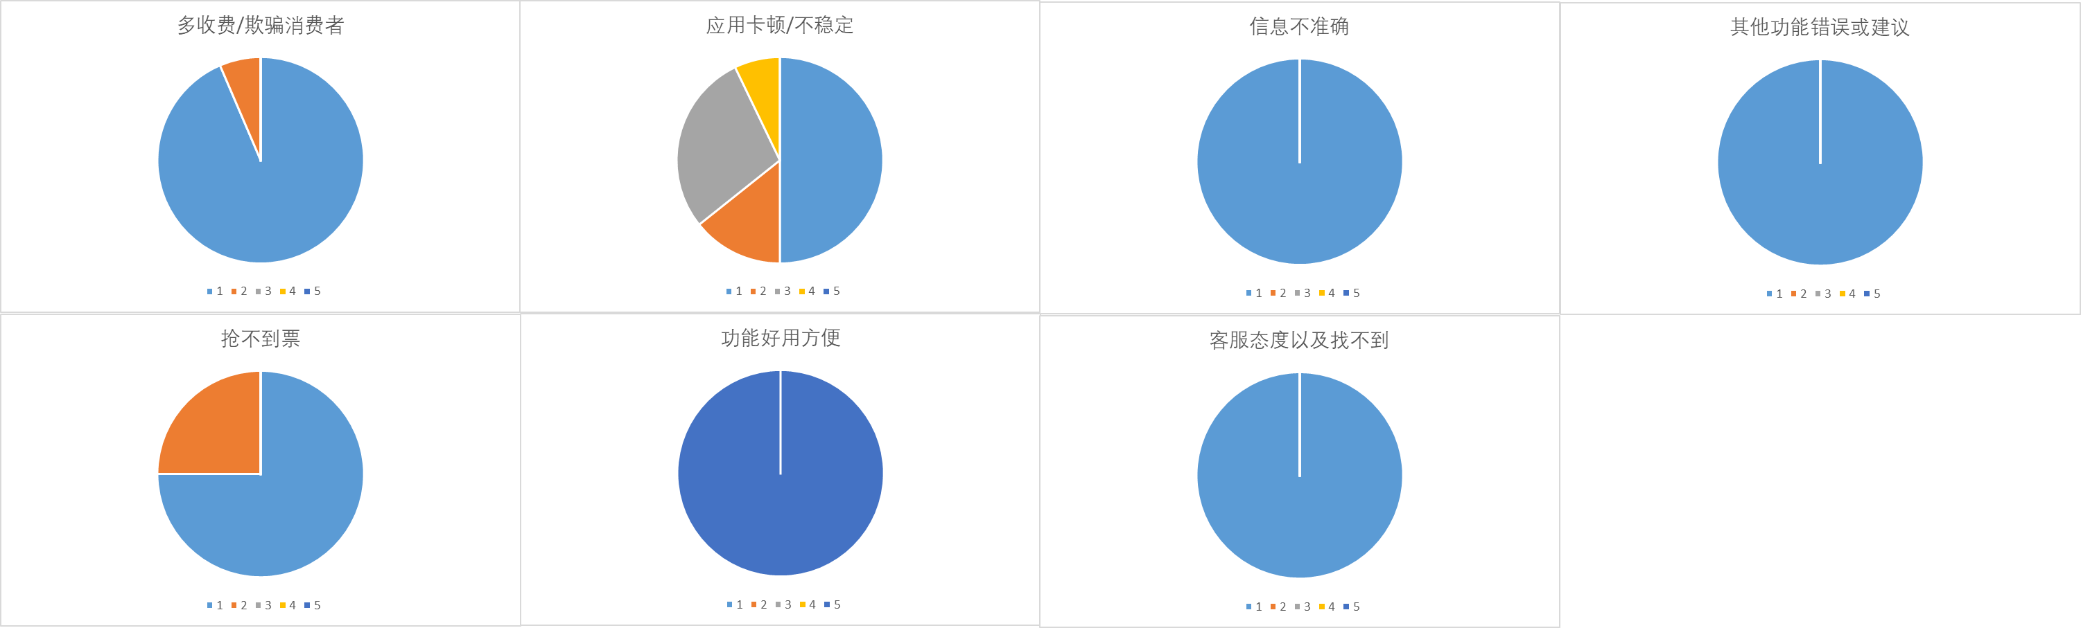
Anaylysis
The distribution of the comment topic
Notes:
具体内容参造评论内容分析word

Slide 22
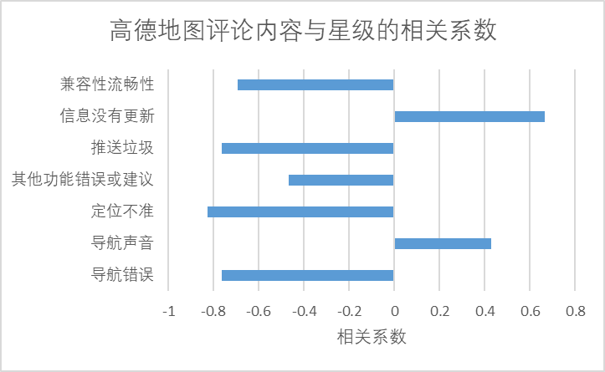
Anaylysis
The relation of the comment and rank
Notes:
携程/去哪儿 水军太多…就没法分析

Slide 23
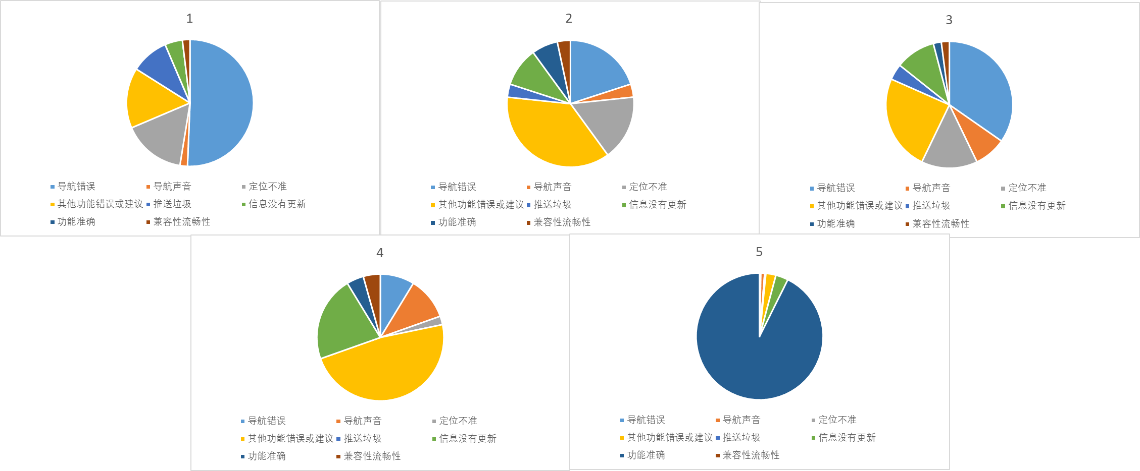
Anaylysis
The distribution of rank（高德）
Notes:
、

Slide 24
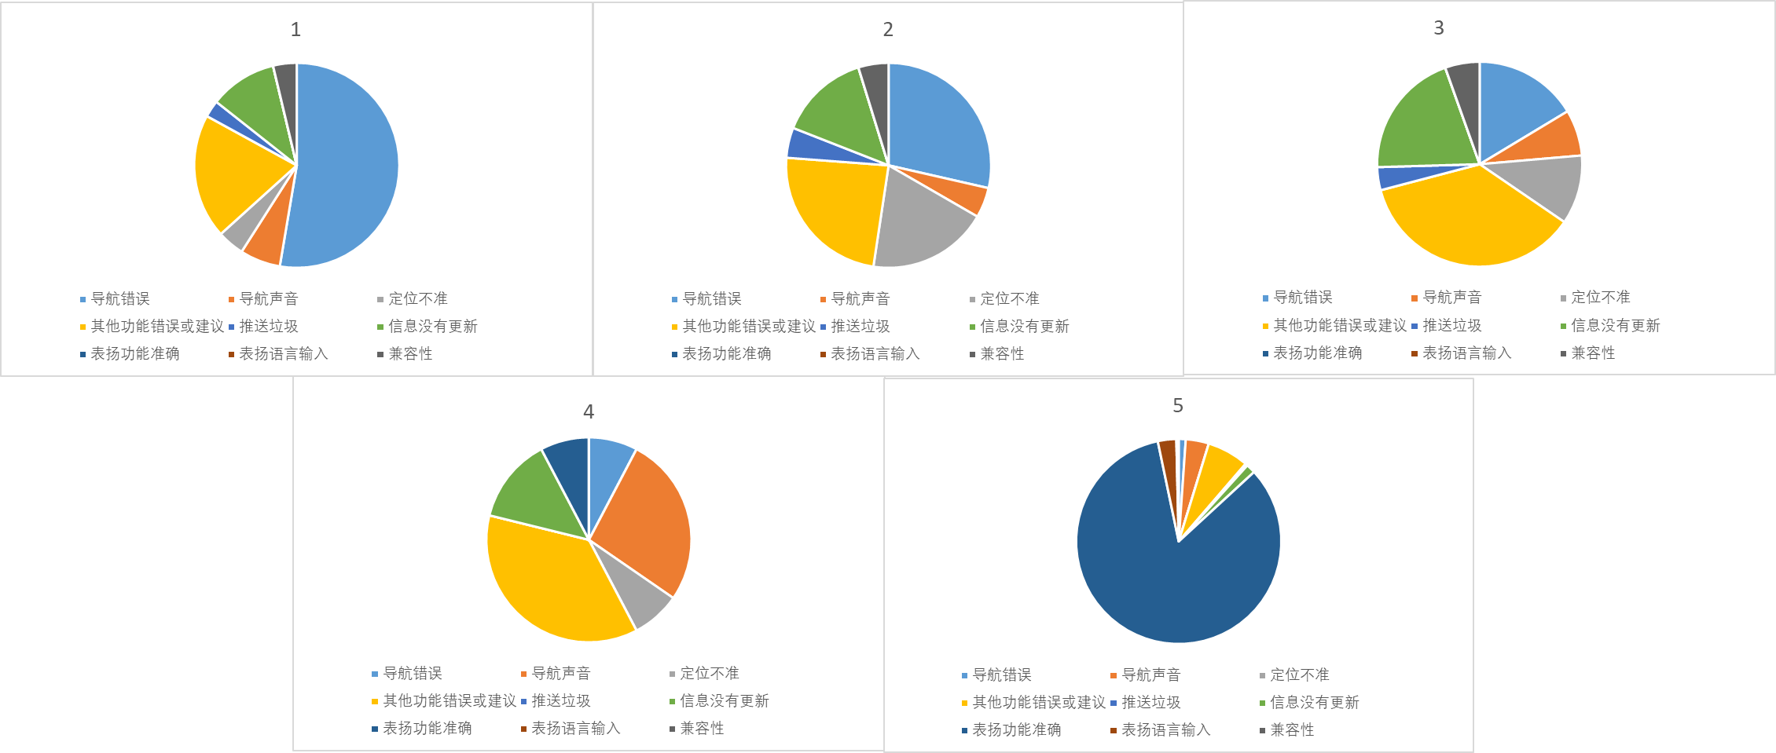
Anaylysis
The distribution of rank（百度）
Notes:
、

Slide 25
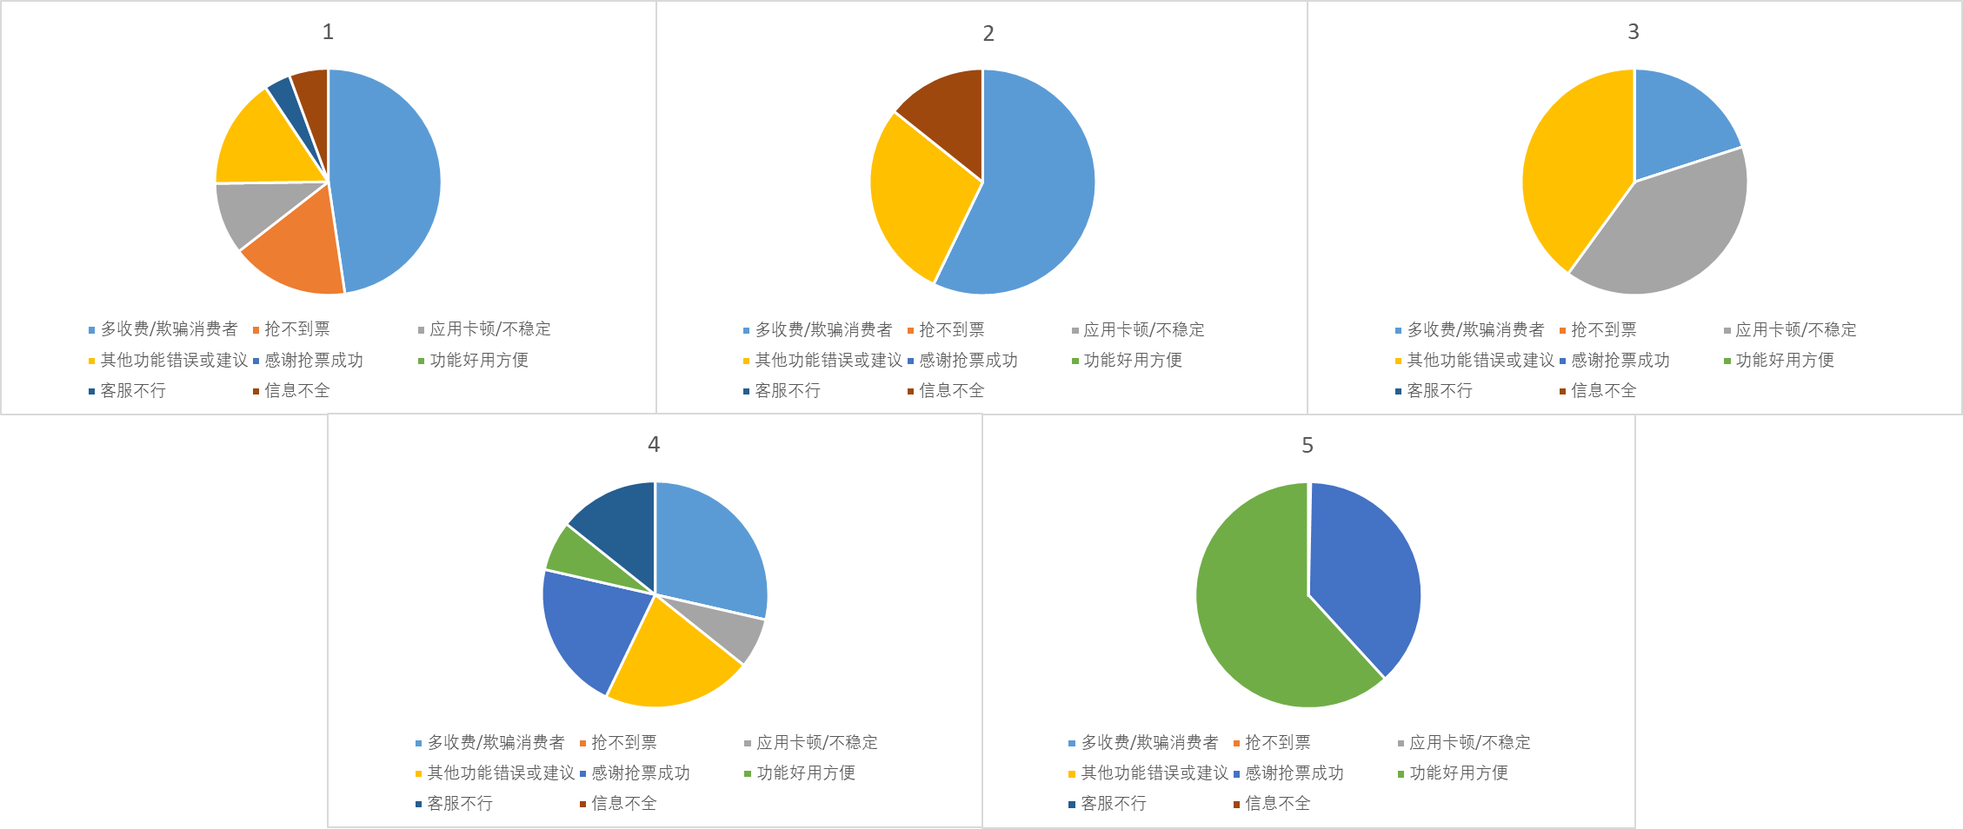
Anaylysis
The distribution of rank（携程）
Notes:
、

Slide 26
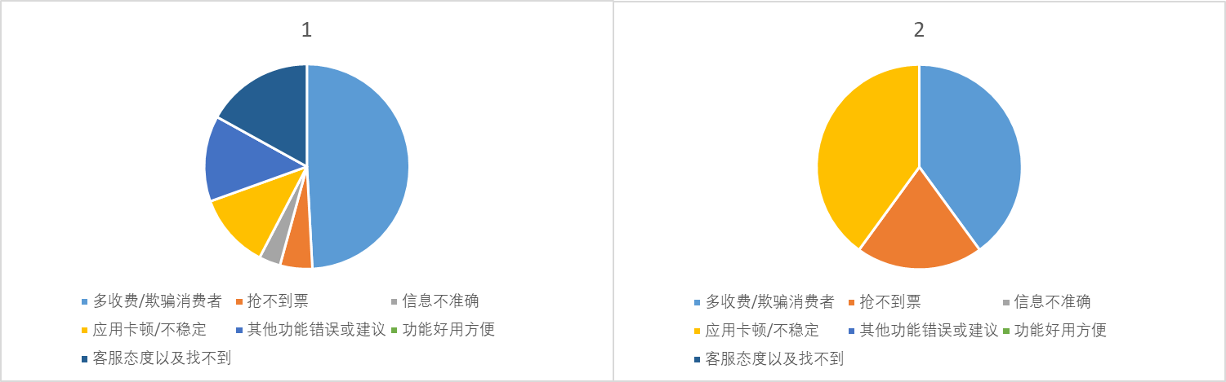
Anaylysis
The distribution of rank（去哪儿）
Notes:
5星水军太多….

Slide 27
目录 Contents
1
Background
2
Idea
3
The collection of the data
4
analysis
5
conclusion

Slide 28
Conclusion
Make the main function well
Navigation and ticket service
Make the app work fluently.
Then make the information right and enough , both for navigation, and ticket.
Audio navigation is an important issue
Then, improve other function.
Notes:
按照重要度顺序排列

Slide 29
THANKS！

